Slide 1
The Hubble Telescope Nebula
Goal - To visit each of the four target areas within the time limit.
Category - Autonomous
Time Limit - 7 Minutes (for all 3 rounds)
Three run attempts are permitted,not compulsory but encouraged,
Two methods of operation
Ranks are calculated after all the players finish.
The shortest run of the three runs will be used to rank.
The robot with the shortest time will take first place.
 | Method 1 | Method 2
Order of zones | Red, Blue, Yellow, Green. | Any order
each colour zone entered | 35 | 30
All zones in correct order/ all zones entered | 30 | 25

Slide 2
The Hubble Telescope Nebula
Penalties :
One rescue per run without penalty but the clock will not be stopped.
A second rescue is permitted, incurring a 15 second penalty.
A third rescue is permitted, incurring a 15 second penalty.
A fourth rescue is not permitted, instead the run must be abandoned.
Abandoned or non-completed runs will not count towards the shortest run time, however any points accumulated during the incomplete run will count towards the overall score.

Slide 3
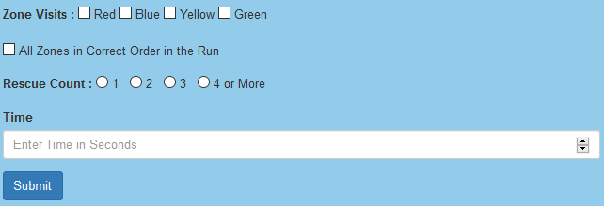
The Hubble Telescope Nebula
Team Name :
Method :
Round 1
Round 2
Round 3

Slide 4
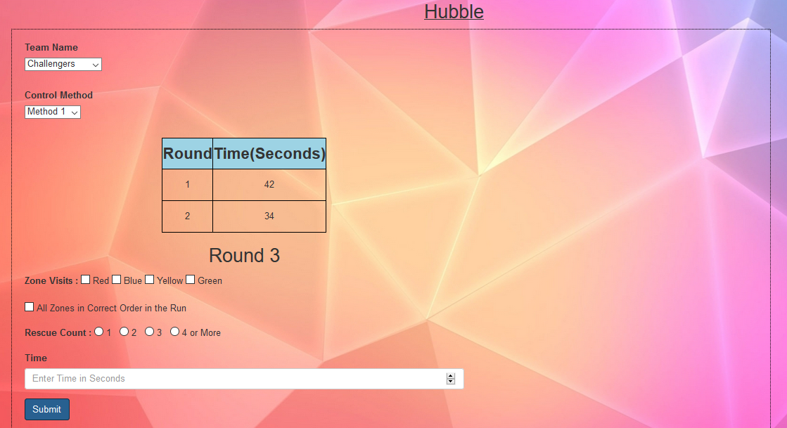
The Hubble Telescope Nebula-Prototype

Slide 5
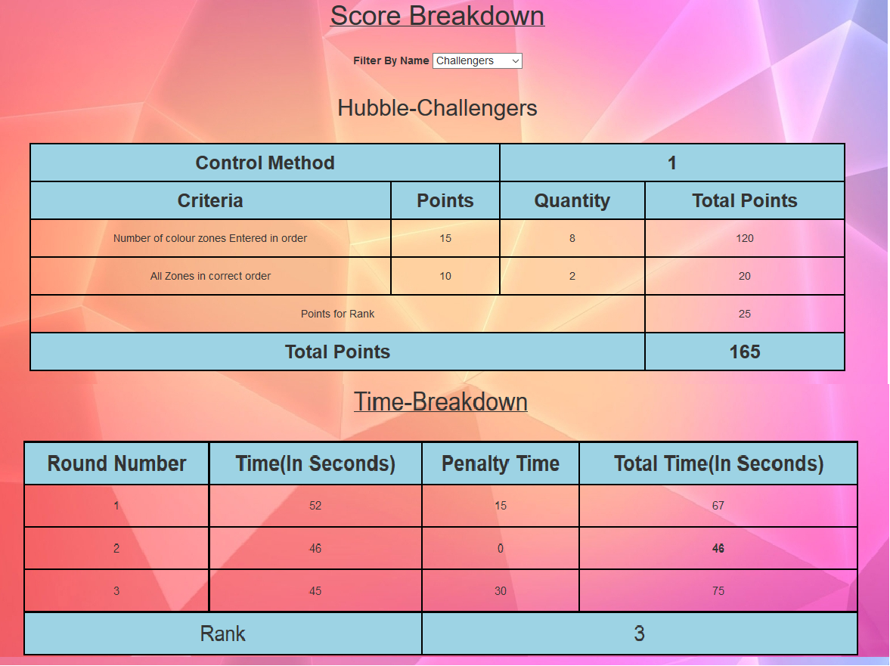
The Hubble Telescope Nebula

